Slide 1
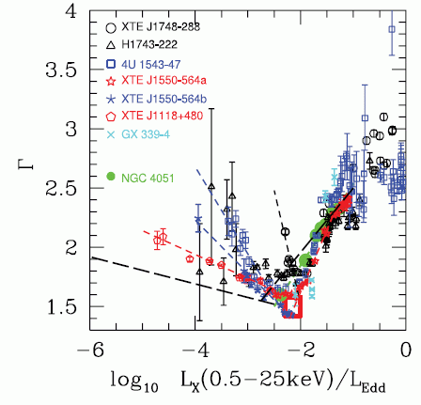
Empirical Links between
XRB and AGN
Accretion Processes
XRB
Anca Constantin
James Madison Univ.
AGN
W/ Paul Green(SAO)
Tom Aldcroft (SAO)
HongYan Zhou(USTChina)
Daryl Haggard (UWashington)
Scott Anderson(UWashington)
Dong-Woo Kim(SAO)
-based on the ChaMP Collaboration

Slide 2
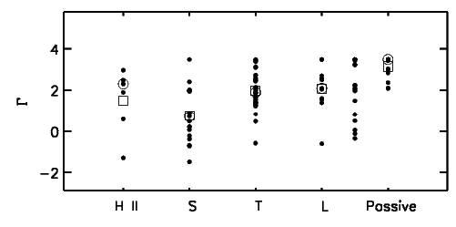
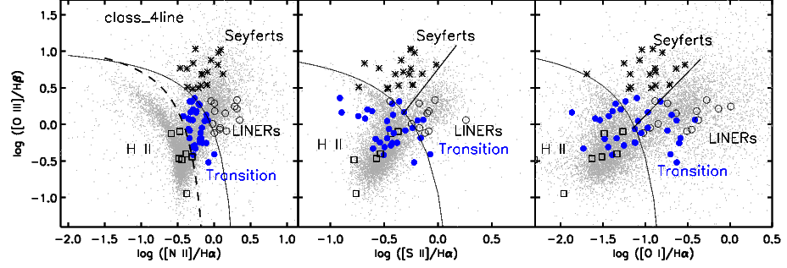
ChaMP data: test sequence
HII → Seyfert → Transition Obj. → LINER → Passive
107 X-ray detected SDSS (DR4) galaxies with spectra (MPA/JHU line measurements)
z < 0.37, to include Hα
No BLAGN
Only 13 are targets
Host properties are identical to those of optically selected samples
→ minimal X-ray Selection effects
[O III]/Hβ
[N II]/Hα
[S II]/Hα
[O I]/Hα
Constantin et al. 2009, “Probing the Balance of AGN and Star-forming Activity in the Local Universe with ChaMP”, ApJ , 705, 1336

Slide 3
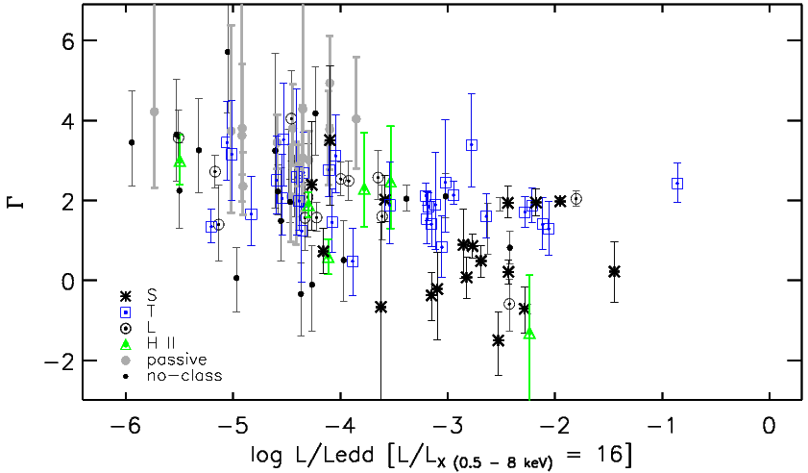
ChaMP data: → An interesting correlation: Γ − L/L_{edd}
107 X-ray detected SDSS (DR4) galaxies with spectra (MPA/JHU line measurements)
z < 0.37, to include Hα
No BLAGN
Only 13 are targets
Host properties are identical to those of optically selected samples
→ minimal X-ray Selection effects
See also Gu & Cao 2009, MNRAS, 399, 349
[O III]/Hβ
[N II]/Hα
[S II]/Hα
[O I]/Hα
Constantin et al. 2009, “Probing the Balance of AGN and Star-forming Activity in the Local Universe with ChaMP”, ApJ , 705, 1336

Slide 4
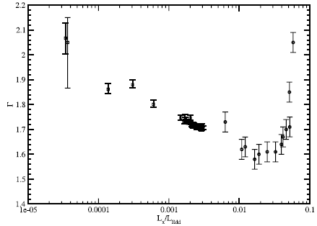
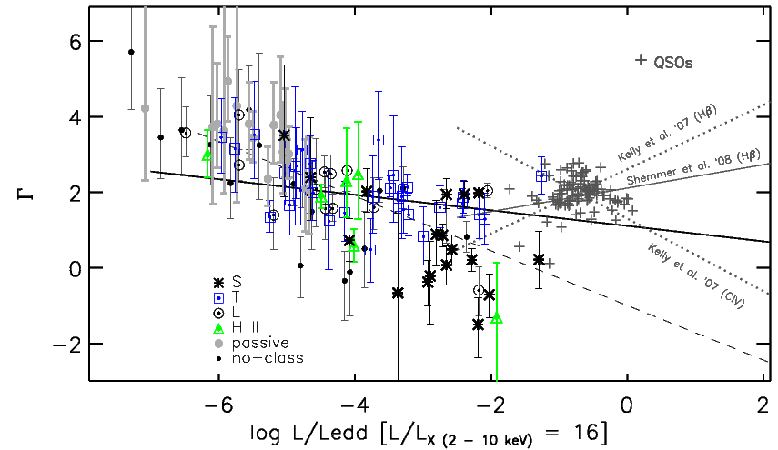
Reasons for being a really interesting Γ − L/L_{edd} (cor)relation:
1. opposite to what is seen in QSOs
inflection point in AGN Γ − L/L_{edd} relation
Γ is not uniquely corresponding to a certain accretion level
⬥ can’t use Γ to estimate M_{bh}
(e.g., Shemmer et al. 06,08; Risality et al. 2009)
2. v. similar to what is seen in XRBs
⬥ Supports XRB-AGN analogy
(e.g., Merloni, Heinz & Matteo 2003; McHardy et al. 2006)
Yuan et al. 2007, ApJ 658, 282
XTE J1550-564
XTE J1118+480
+ QSOs
Wu & Gu 2008, ApJ 682, 212

Slide 5
An inflection point in Γ − L/L_{edd}: what could it mean?
Intrinsic absorption is blown away towards the (high) QSO accretion rates.
→ Explanation for the dearth of obscured (type II) QSOs
A transition in the accretion mode:
RIAF(ADAF) --> Shakura-Sunyaev standard accretion disk/corona
-increase in L/L_{edd}→ increase in Compton-y parameter → harder spectrum.
-further increase in L/L_{edd} → increase energy release → decrease in T → weaken corona, lower optical depth → reduction in y-parameter → softer spectra.
AGNs
Wu & Gu 2008, ApJ 682, 212
XRBs

Slide 6
❖ Does it make physical sense?
ADAF accretion: negative correlation expected
(e.g., Esin, McClintock & Narayan 1997)
synchrotron emission from relativistic jet
(e.g., Falcke et al. 2004, Wu et al. 2007, Gliozzi et al. 2008)
→ possibly for Lx/L_{edd} < 10⁻⁶
2-zone accretion disk, i.e., outer standard disk + inner ADAF → to manage the inflection point (e.g., Lu & Yu 1999)
log νL_{ν} (erg/s)
log ν (Hz)
❖ Is the inflection/correlation real? Caveats:
Optical spectral measurements not homogeneous for type 1 and 2.
M_{bh} estimated based on different methods.
  M−σ* for NELG+passive galaxies; broad line fitting for BLAGN
bolometric corrections not trustworthy, particularly for NELG+passives;
  no truly nuclear data available for low L objects.
only simple power-law fits to X-ray data: Γ =hardness ratio

Slide 7
Γ − L/L_{edd}: new data & better measurements
~600 Chandra Source Catalog -- SDSS (DR7) galaxies with spectra
z < 0.37, to include Hα
include BLAGN
Improved and homogeneously applied optical spectral fitting/analysis for type I & II sources.
M_{bh} estimated consistently throughout the sample.
simultaneous X-ray spectral fitting of sources with multiple observations.
careful about background modeling using Cash statistic fitting → parameter estimates for low-count sources.
à la Zhou et al. 2006,ApJS,166,128
BLAGN
[O III]/Hβ
NELG
[O III]/Hβ
[N II]/Hα
[S II]/Hα
[O I]/Hα
Notes:
580 sources = discard ~200 as Gamma measurements not reliable. Need further investigation; possibly revealing new types of sources not researched before: very hard, very low L/Ledd.
With accurate Gamma measurements: 441= 100 passive, 198 nelg, 143 blagn

Slide 8
Γ − L/L_{edd}: constraints as a function of M_{bh}
M_{bh} based on σ* for all objects
--no particular dependence on M_{bh}:
~ same inflection point for all ranges
-tighter correlation for BLAGN with
M_{bh} based on FWHM(Hβ)
Laor et al. 1997: Γ ~ FWHM(Hβ)
Notes:
--Correlation is robust to Mbh estimator.

Slide 9
Γ − L/L_{edd}: Lx, f_{AGN}, spectral classes
40 < logL_{x}< 41
41 < logL_{x}< 42
logL_{x}> 42
BLAGN, f_{AGN}>0.5
inflection point remains unchanged for different Lx ranges
Requiring strong AGN (power law)component in spectra (f_{AGN} >0.5) does not tighten the correlation
all spectral types show negative correlation
--even the LINERs and HIIs
ADAF could be the dominant accretion process in the low L/Ledd
Notes:
Given what a mixed bag Ls are, this is quite surprising.

Slide 10
SUMMARY (i.e., homework for theoretical modeling of AGN accretion)
Γ − L/L_{edd} is non-monotonic: changes sign at log Lx/Ledd ~ -3.5
strong connection in the accretion physics of AGN and XRBs!
Location of inflection point is independent of:
- range of M_{bh}
- optical spectral class
-X-ray activity
-morphology
-…
All spectral classes of NELGs show negative
− L/L_{edd} correlation
COMING SOON:
Simultaneous constraints on continuum and absorption in X-ray data.
Include radio data; investigate relationship of jet activity to accretion
check Γ − L/L_{edd} relationship as a function of environment.

Slide 11
Γ − L/L_{edd}: Lx, f_{AGN}, and M_{bh} again
40 < logL_{x}< 41
41 < logL_{x}< 42
logL_{x}> 42
BLAGN, f_{AGN}>0.5
inflection point remains unchanged for different Lx ranges
Requiring strong AGN component in spectra (f_{AGN} >0.5) does not tighten the correlation
40 < logL_{x}< 41
41 < logL_{x}< 42
logL_{x}> 42
Any link with Γ − M_{bh}?
flat for Lx>10⁴² erg/s
Non-monotonic for lower Lx
--possible break at M_{bh}~ 3×10⁷ M_{sun}?
Notes:
The relation is pretty flat for everything that is AGN by X-ray standards; however, the relation appears to become non-monotonic, like the Gamma-L/Ledd, with a possible inflection somewhere between 10^7 – 10^8 Msun.

Slide 12
Γ − L/L_{edd}: as a function of spectral class -or- morphology
all spectral types show negative correlation
--even the LINERs and HIIs
(are our Ls radio quiet? no jet component?)
no apparent inflection for spirals; obvious for star-like sources.
Seyferts and mergers: steepest correlation
→ correlation with absorption?
Notes:
This is rather preliminary, more speculative results, that need additional considerations – but will give you a good idea of the direction we’re heading to.
As expected, passives are the softest. X-ray activity most probably is of thermal origin, from extended gas.
You’d just wonder what good is the bpt diagram for? All types of objects=all over the place; no separation of any kind as a function of spectral class.
Morphology=our own galaxy zoo style classification.
-Spirals behave like the Ss: no inflexion point here, no softening fir higher Lx/Ledd; Ss in BLAGN pick up the slack though; less obvious for spirals.
-star-like sources show inflexion.
Ts & Ss have the largest Lx/Ledd among NELGs -- opposite directions beyond inflexion point

