Slide 1
Spectral Analysis,
Uncertainties in Atomic Data,
And AtomDB
Randall Smith, Adam Foster (SAO)
Stuart Loch & Connor Ballance, Auburn University
Michael Witthoeft, NASA GSFC

Slide 2
Some (Personal) Definitions
Error
  Statistical: 9 counts in a line can measure a flux to at best 3σ.
  Systematic: Unknown/unmeasured behavior of the measuring system itself.
Uncertainty
  Relevant to theoretical atomic calculations. These inherently rely upon approximations whose applicability may not, or possibly can not, be tested.

Slide 3
Solve the Important Problems First!
Bremsstrahlung continuum depends upon emission measure and temperature. The atomic physics is known to a gnat’s eyelash*
Line ratios between different ions depend exquisitely on the temperature and the charge state distribution. Uncertainties in atomic line formation rates hardly matter.
Broad spectral fits in the UV/X-ray depend largely on the bremsstrahlung, the He-like lines, and the Fe L shell, in that order.

Slide 4
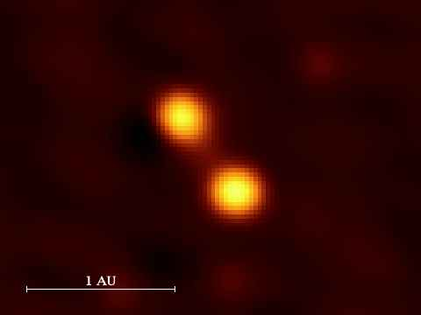
“X-ray Line Emission from Capella”
A G III binary system ~13 pc distant

Slide 5
“X-ray Line Emission from Capella”
1980’s
Mg, Si, S, and Fe are unambiguously detected
Inconsistent with an isothermal corona, and requires components between 6 – 24 x10⁶ K for an adequate fit.
Suggests an X-ray emitting plasma confined to magnetically contained loops explains the data.
Holt et al. 1979
7 ksec exposure with the Einstein Solid State Spectrometer

Slide 6
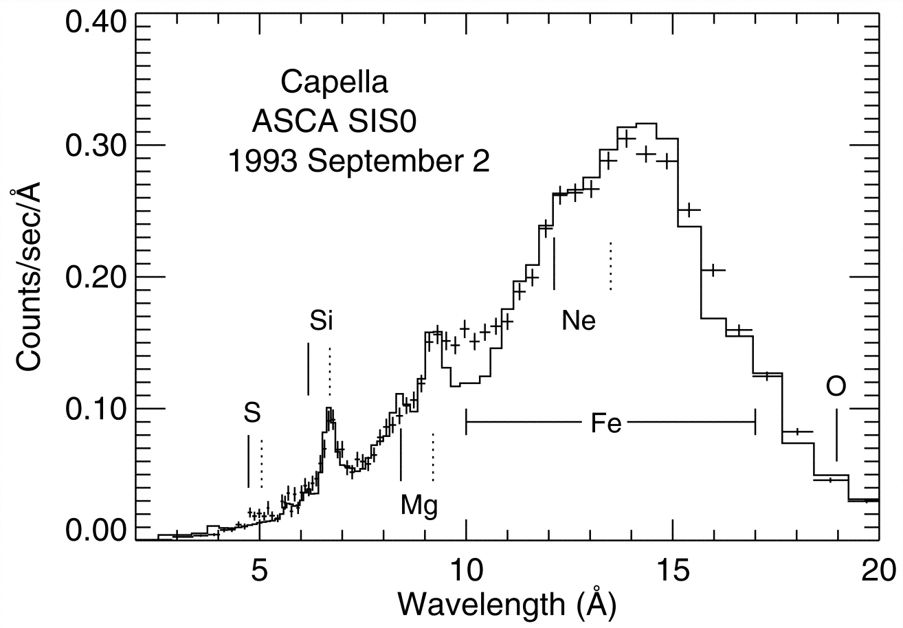
“X-ray Line Emission from Capella”
1990’s
Coronal Structure and Abundances of Capella from EUVE and ASCA Spectroscopy
Collisional plasma models appear to have flux deficits.
New atomic models allow reliable determination of elemental abundances.
EUVE data are not well fitted with only two temperatures.
Mg, Si, S, and Fe consistent with solar photospheric values, while Ne appears to be under-abundant by a factor of ~3 to 4.
21 ksec obs. w/ASCA Silicon Imaging Spectrometer (Brickhouse et al. 2000)

Slide 7
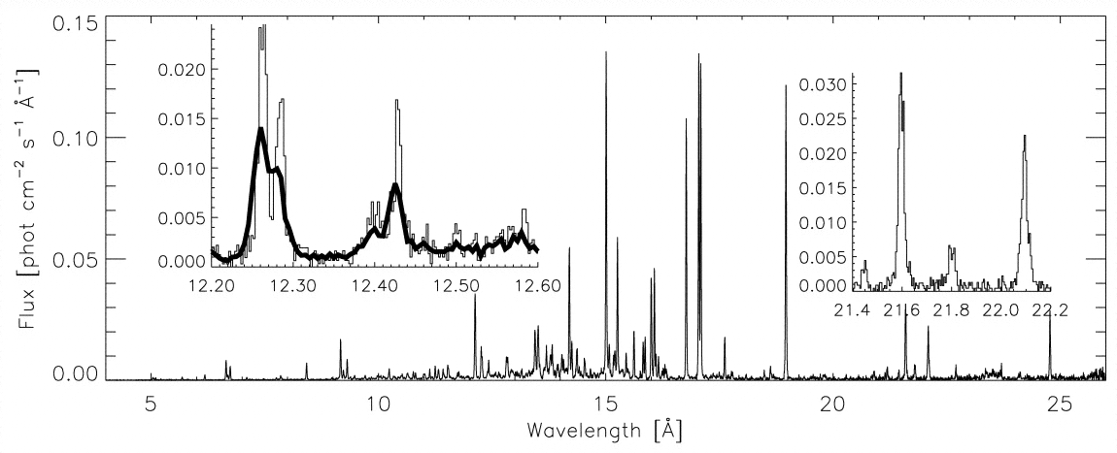
“X-ray Line Emission from Capella”
2000’s
High-Resolution X-Ray Spectra of Capella: Initial Results from the Chandra High-Energy Transmission Grating Spectrometer
89 ksec w/Chandra HETG (Canizares et al. 2000)
Broad range of temperatures, from T = 2 – 15 x10⁶K
The electron density is ~ 10¹⁰ cm⁻³ at T_{e}~2 × 10⁶ K.
The density and emission measure show the coronal loops are significantly smaller than the stellar radius.

Slide 8
“X-ray Line Emission from Capella”
2010’s
Chandra/HETGS Observations of the Capella System:
The Primary as a Dominating X-ray Source
104 day orbit
326 ksec over 6 years with Chandra/HETG
Primary G8 III star, not the secondary G1 III star, dominates the X-ray emission
Hotter gas (Fe XXI) shows more variation with phase

Slide 9
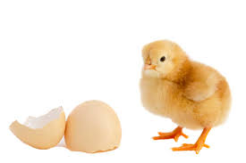
Back to Uncertainties:
Chicken, meet egg.
There are no published uncertainties for most values, so we cannot put them in models
There are no models ready to use uncertainties, so why calculate them?

Slide 10
And this does have a real impact
SYNTHESIS AND SUMMARY COMMENTS:
“While recognizing the value of this work, the review panel was not convinced that there would be a significant impact on astrophysics by having a better handle on uncertainties in the atomic data…”
Quote from a recent proposal review panel.

Slide 12
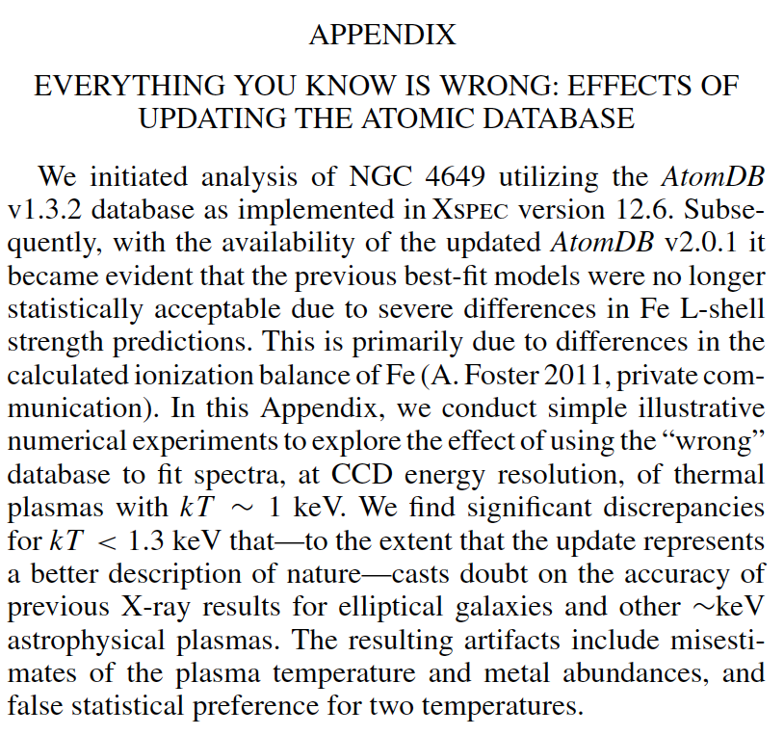
But Don’t Lose Hope
Loewenstein & Davis (2012, ApJ, 757, 121)

Slide 13
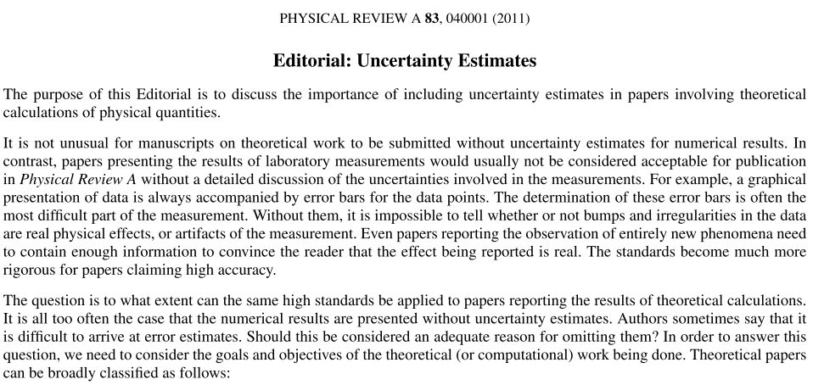
There is interest

Slide 14
Phys Rev A: a New Hope
Structure calculations now routinely include uncertainties – but
Scattering calculations... not so much. So they avoid PhysRevA

Slide 15
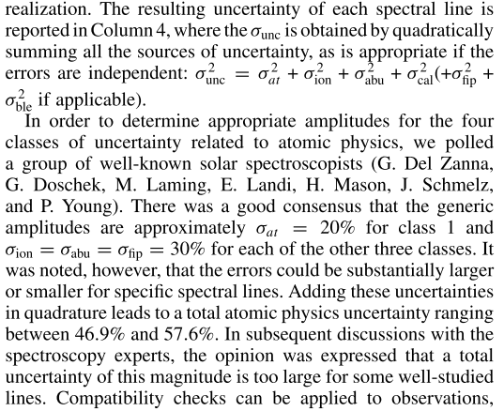
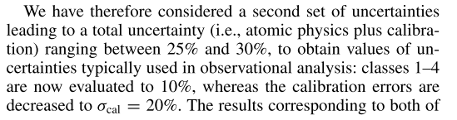
Current Best Methods...
Guennou+2013

Slide 16
Where are we now, anyway?
Calculated atomic transitions exist for nearly all X-ray relevant ions.
  Distorted Wave for most
  Higher-quality R-matrix or CCC methods for some key ions (H-like, He-like, some Fe L)
Lab measurements for some, allowing cross-checks
High-resolution absorption cross sections for some abundant atoms

Slide 17
Meaningful Uncertainties Matter

Slide 18
Charge State Distributions
Regularly updated (Bryans+ 2009); new Fe data has some significant changes from the older Mazzotta+ data

Slide 19
Impact of CSD Uncertainty

Slide 20
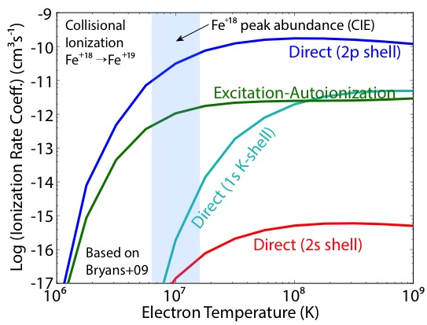
Baby Steps: Estimating Errors in Charge State Distributions

Slide 21
Ratio of ionization rates computed using FRDW calculations and RCCC for iron, and the effective shift in the ionization balance. At typical cluster temperatures (3-6keV) the ionization fraction changes by > 10% for Fe²⁴⁺

Slide 22
CSD vs Line Uncertainties
There are 100s of cross sections and/or rates involved in calculating the CSD.
  Rates are temperature, and to an extent, density dependent
  Correlations abound
For any given ion, there are 1000s to millions.
There are billions involved in calculating all of the line-emission processes

Slide 23
Wavelength Error Data

Slide 24
Wavelength errors incomplete

Slide 25
100 strongest lines from a kT=0.3 keV plasma, SPEX vs AtomDB
Line Emissivity (Relative to Peak)
Wavelength (Å)

Slide 26
100 strongest lines from a kT=2 keV plasma, SPEX vs AtomDB
Line Emissivity (Relative to Peak)
Wavelength (Å)

Slide 27
Line Ratio Errors May Already Be Cropping Up…
Nevalainen+ 2010

Slide 28
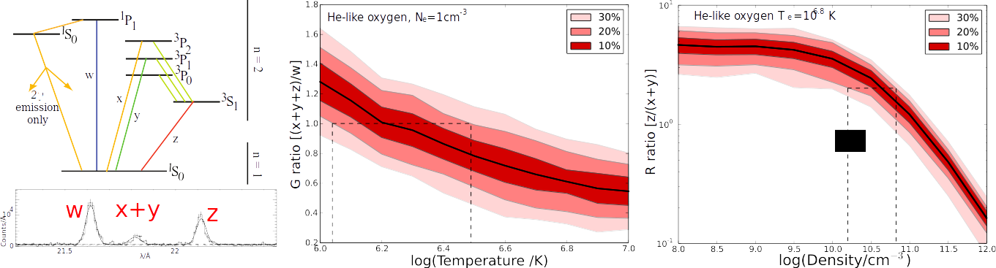
Naive approach:
Put 10, 20, 30% errors on everything
x3!
(And let the referee sort it out)

Slide 29
Naive approach
x3!
We know nothing! Pack up the satellites. Let's go home.
Except…I have heard there are good restaurants in Bern.
Perhaps a little more effort?

Slide 30
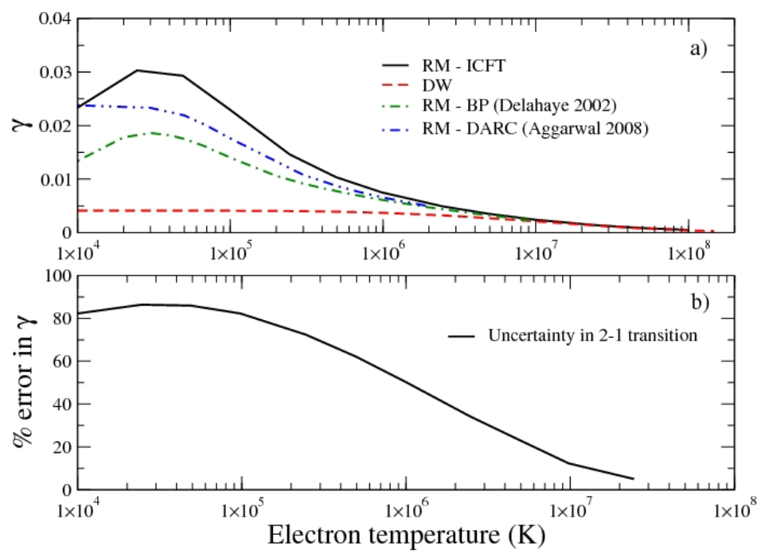
Collisional Excitation
Example: O⁶⁺ Forbidden excitation – large errors

Slide 31
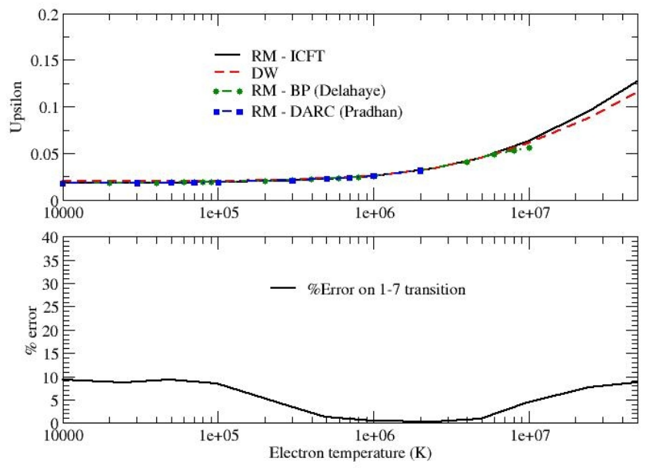
Collisional Excitation
Baseline: Compare values from large and small basis sets using DW calculations. Also compare resonance free DW with resonance handling R-matrix
Example: O⁶⁺
Resonant excitation: low errors.

Slide 32
Atomic Calculations & Line Emissivity
All atomic structure calculation have inherent uncertainty
  E.g. the # of configurations used, or the type of relativistic corrections
  Typical uncertainties in the energies (and thus wavelengths) in highly charged systems are ~1-5%, though accuracies better than 0.1% are possible,
In a structure calculation the Thomas-Fermi orbital scaling parameters can be adjusted, with ranges determined by neighboring ions, providing a range of energies as an uncertainty.
  This impacts oscillator strengths and also DR rates, which rely heavily of the exact position of near-threshold energy levels.
For collisional calculations such as ionization, one can shift between the post and prior central potential, i.e. using either the N or N+1 electron system to generate the scattering basis.

Slide 33
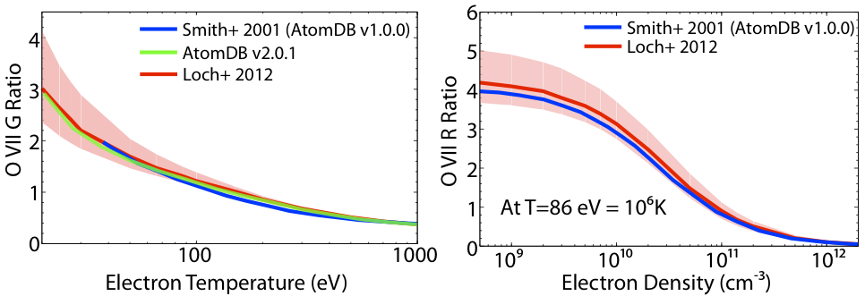
Errors / Sensitivity Testing
Theoretical calculations can use Monte-Carlo methods, varying the input atomic structure or calculation size to estimate sensitivities. Care is needed in using these, but they are better than providing no estimate at all.
See also Bravo & Martínez-Pinedo (2012)

Slide 34
Correlation…

Slide 35
Conclusions

Slide 36
Individual Line Ratios
Relatively straight forward.
Put uncertainties on the G and R ratios and so on.
Must consider the contribution from each source to be correct, e.g. ionization-cascade vs excitation.
But probably a tractable problem.

Slide 37
Whole Spectrum Fitting
Requires carrying uncertainty, and correlations, into fitting in an intelligent way.
  Correlate lines from same element?
  Lines from same ion?
  Lines from same upper level?
Must work (not require supercomputer to fit a simple Gaussian)
Should also handle missing data errors in a graceful fashion

Slide 38
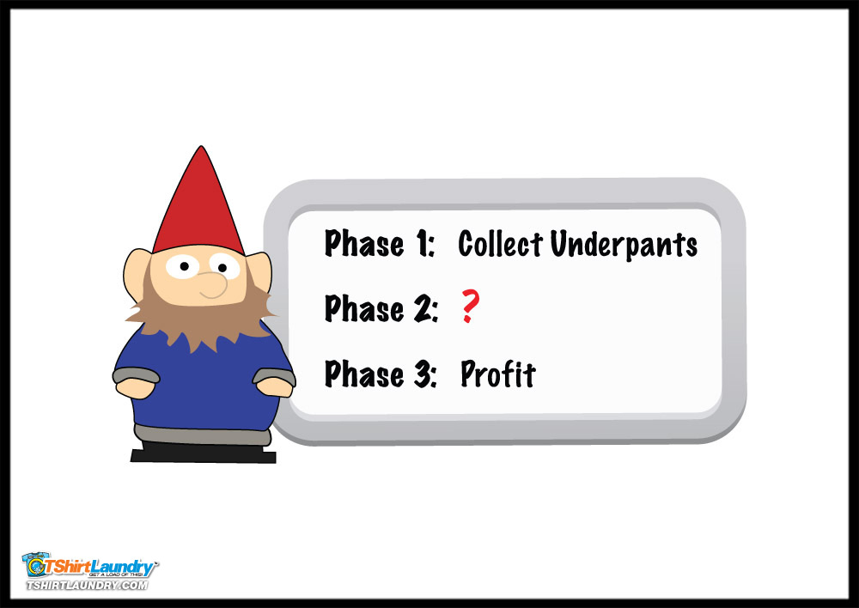
Implementing for Spectral Analysis
Calculate correlated
Uncertainties
Profit!

Slide 39
Backup

Slide 40
Fe XVII: Physics & Theory
Data
from
LCLS

Slide 41
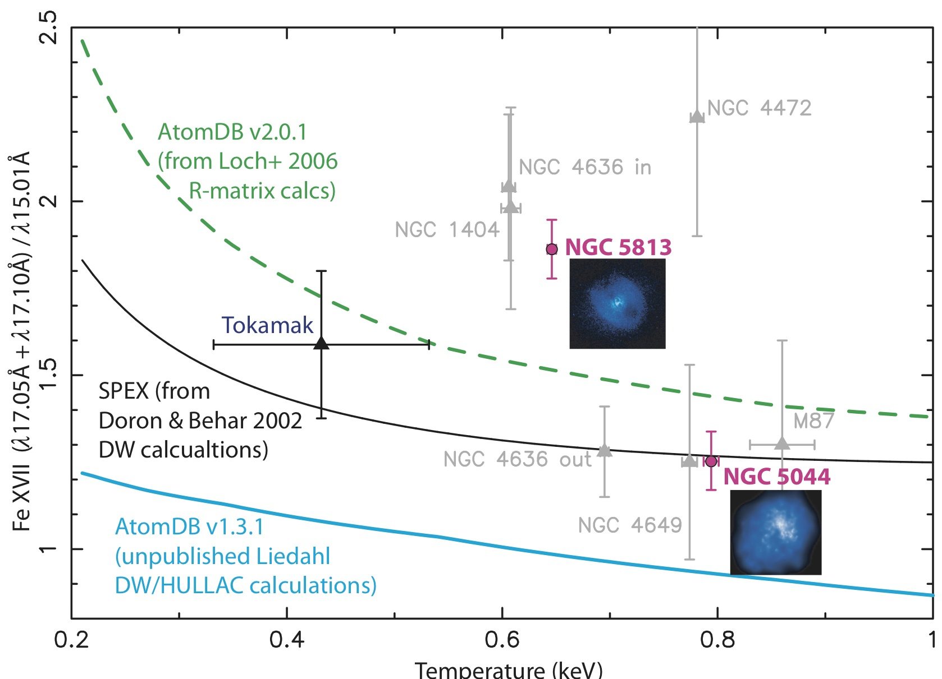
Fe XVII: Astrophysics & Theory
dePlaa+ 2012
Notes:
Fe λ15.01Å has an oscillator strength of ~2.5, so a dense, low-turbulence environment causes scattering that
increases the observed ratio. But how to explain NGC5044?

Slide 42
Fe XVII: Astrophysics & Theory
Gillaspy+ 2010

Slide 43
TW Hya: Accretion & X-rays
TW Hya: A 10 Myr old “Sun” that is
still growing by accreting mass from a disk
TW Hya, Chandra HETG
TW Hya, Chandra HETG
Brickhouse et al. 2010
Brickhouse et al. 2010

Slide 44
Helium-like Diagnostics
Brickhouse+ 2010
While the temperature diagnostics for Mg XI, Ne IX, and O VII all give roughly the same result, the density diagnostics are significantly different.

