Slide 1
Period finding in astronomical time series
Pavlos Protopapas
Time Series Center
Harvard Smithsonian Center for Astrophysics,
School of Engineering and Applied Sciences, Harvard

Slide 2
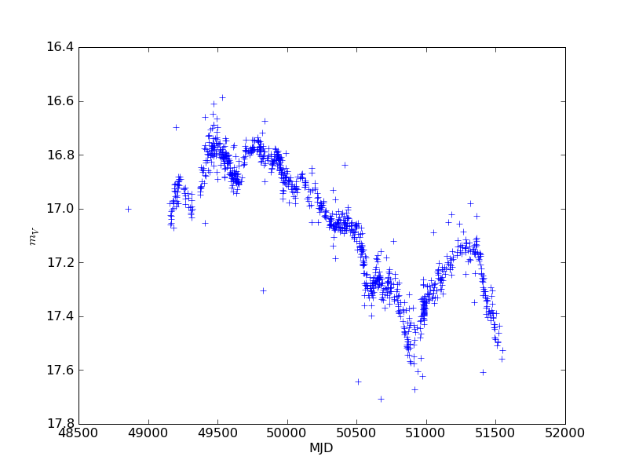
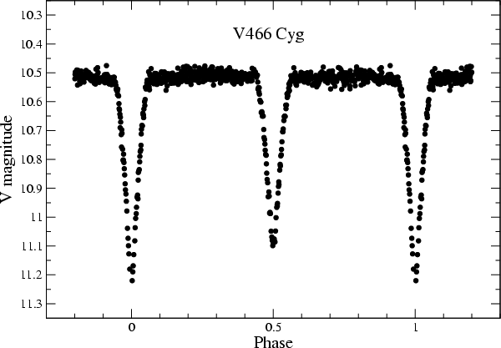
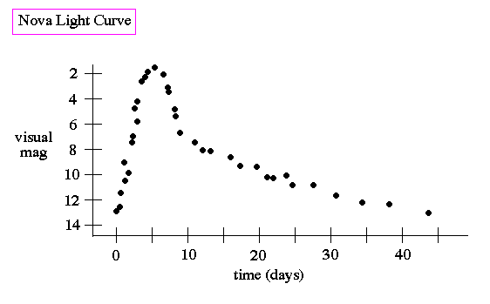
Motivation
Pan-STARRS, LSST etc are/will be producing millions of lightcurves.
Can we classify them using automatic methods ?
Can we use variability as a discriminator?

Slide 3
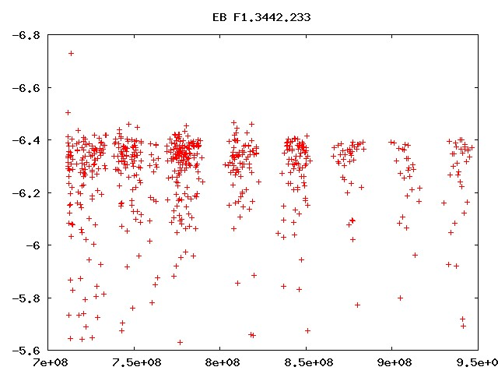
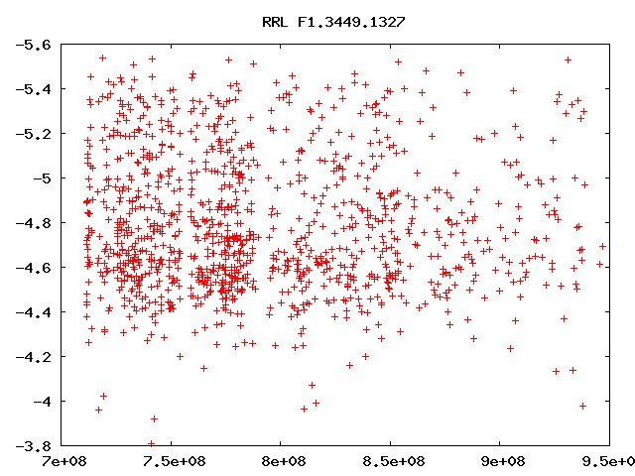
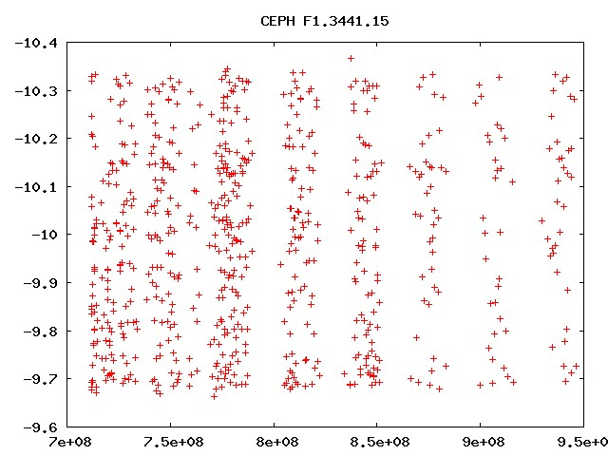
Motivation
Answer is yes..
e.g. Wachman 2009, Mahabal 2008, Richards 2011
Keystone: Period determination. Finding period or determining if periodic depends on the SNR and sampling pattern. For irregular sampled data we get ~75% with LS and many many false positives.
(also it depends how you ask the question and who you ask the question).
We need to do better.
Notes:
ADD CLASSIFICATOR

Slide 4
folding

Slide 5
Folding methods Phase Dispersion Minimization
Stellingwerf 1978: Phase Dispersion Minimization (PDM)
(where series X={x₁, x₂, …,x_{N}}
For any subsample of x we define the variance exactly as above.
If you choose M sub-samples and s_{j}² is the variance of sample j
then the overall variance of all samples is
Notes:
$\sigma^2 = \frac{\sum (x_i-\hat{x})^2}{N-1} $

Slide 6
For a trial period P_{c} we fold the lightcurve
Define the statistics
Now if the P_{c} is not the true period then Θ∼1 if P_{c} is the correct period then Θ is minimum.
Sub-samples can be anything as long as they have similar φ_{i}

Slide 7
original
folded with incorrect period
Red folded lighcurve
Blue smoothed lightcurve
folded with correct period
Red folded lighcurve
Blue smoothed lightcurve

Slide 8
Peridiograms
The Lomb–Scargle (LS) periodograms method chooses w to maximize for time series {x_{j}, y_{j}} the periodogram defined as:
where η_{j}=w(x_{j}-τ). And the phase τ (depends on w):
Fit harmonics using least-squares
Notes:
P_{LS}(w) = \frac{1}{2} \left\{ \frac{[\sum y_i \cos(\eta_j)]^2}{\sum \cos^2(\eta_j)}+\frac{[\sum y_i \sin(\eta_j)]^2}{\sum \sin^2(\eta_j)}\right\}

Slide 9
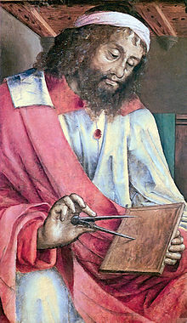
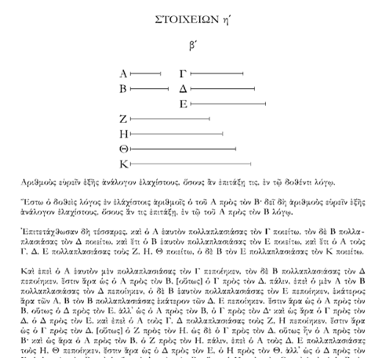
The Greeks
Euclid algorithm
time of a regularly repeated events
calculate the greatest common divisor (GCD) of two natural numbers (that’s period)
147 and 217 have 7 as the largest common divisor
based on fact that the greatest common divisor of two numbers does not change if the smaller number is subtracted from the larger number. 217 − 147 = 70.
The GCD of 147 and 70 is 7 again.
function gcd(a, b)
while b ≠ 0
t := b
b := a mod b
a := t
return a

Slide 10
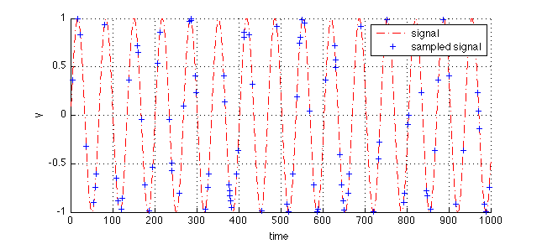
Euclid algorithm finding periods
Simulate a periodic event (red dotted line)
Simulate random observation times.
Find points of the same y-value.
Find GCD of any pair. That is the period.
OF COURSE this is a toy model.
y-values have uncertainties
There are multiple (at least 2) y-values per period.
No confidence/probabilities/posteriors and all that jazz

Slide 11
Entropy Kernel work with Pablo Hujse, Pablo Estaves, Pablo Zegers and Jose Principe
Entropy Kernel is a generalization of the conventional correlation function.
Let a discrete-time strictly stationary univariate random process {X_{n}, n=1..N}, where N is the length of the sequence, the one can define as

Slide 12
Kernel
Gaussian kernel contains all even-order moments, and in particular the second-order moment that corresponds to the autocorrelation.
The kernel size σ controls the emphasis given to higher-order moments over the second moment

Slide 13
Gaussian Kernel aka Correntropy
The name correntropy comes from the fact that it looks like correlation but the sum over the lags (or over dimensions of the multivariate random variable) is the information potential (i.e., the argument of Renyi’s quadratic entropy
Renyi’s quadratic entropy is a generalization of the Shannon entropy (uncertainty associated with a random variable)

Slide 14
Spectral Density
The entropy spectral density (CSD) is defined as
The CSD is the Fourier transform of V and it can be considered as a generalized PSD function.

Slide 15
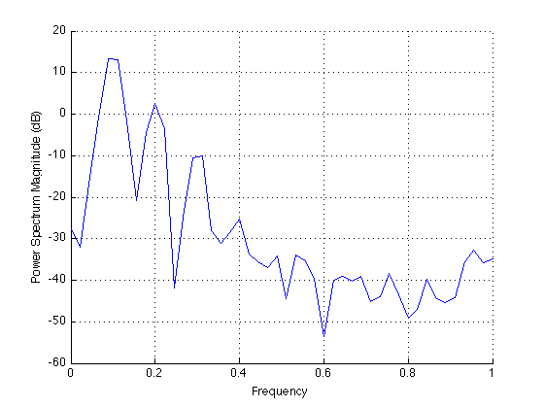
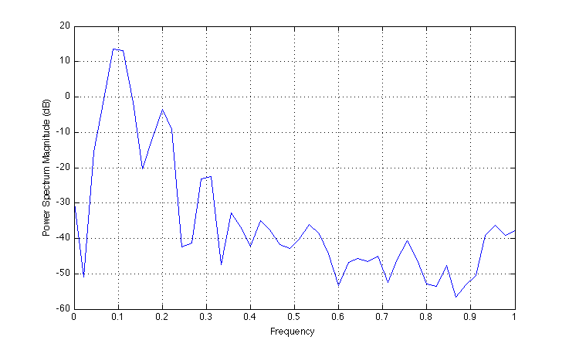
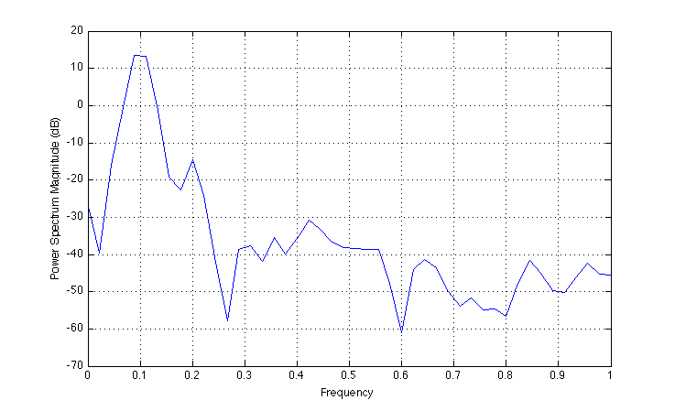
Examples
σ=0.7
σ=5
σ=10

Slide 16
Irregular sampling
Remember we have irregular sampling.
Proposed a slotted method
W. Mayo, “Spectrum measurements with laser velocimeters,” in Proceedings of dynamic ﬂow conference, DISA Electronik A/S DK-2740, (Skoolunder, Denmark), pp. 851–868, 1978.

Slide 17
Information Potential
For every trial period P_{c}
Fold the lightcurve
Divide the folded lightcurve into H sub_samples and estimate the statistic Θ
where

Slide 18
MACHO variables
600 light-curves was drawn from the MACHO survey.
200 light-curves for EBs, Cepheids and RR Lyrae,
periods range from 0.2 days to 200 days.
The periods of these light-curves were estimated by expert
astronomers (that’s ME) from the Harvard Time Series Center (TSC)
Use epoch folding (PDM), and visual inspection.
In this work, we consider the TSC periods to be the gold standard.
Notes:
ADD IMAGES OF LIGHTCURVES

Slide 19
Method
Z-normalize the light curve’s.
Discard samples having an error estimation greater than the mean error plus two times its standard deviation (less than 1% of the samples of a light curve are discarded).
Compute the slotted correntropy.
The maximum lag is set to 0.3 N, where N is the light curve length. This value is chosen as a trade-off between having enough samples to estimate correntropy with longer lags and bounding the longer period that could be detected.
Store the periods associated with the highest peaks of the CSD. For each trial period compute the IP metric as shown before
Notes:
ADD IMAGES OF LIGHTCURVES

Slide 20
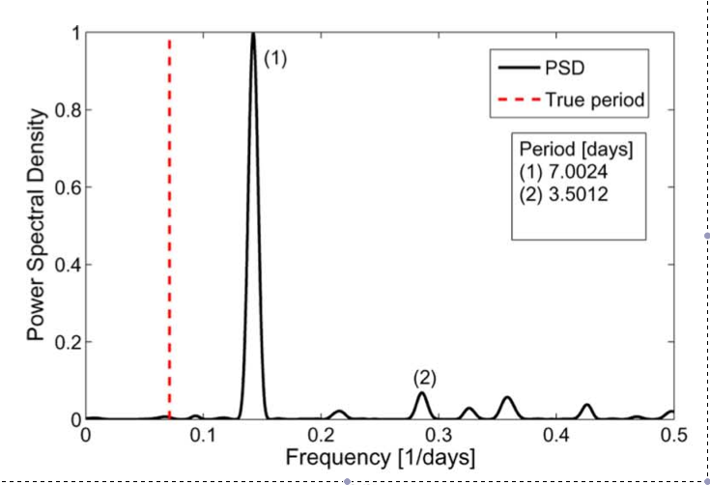
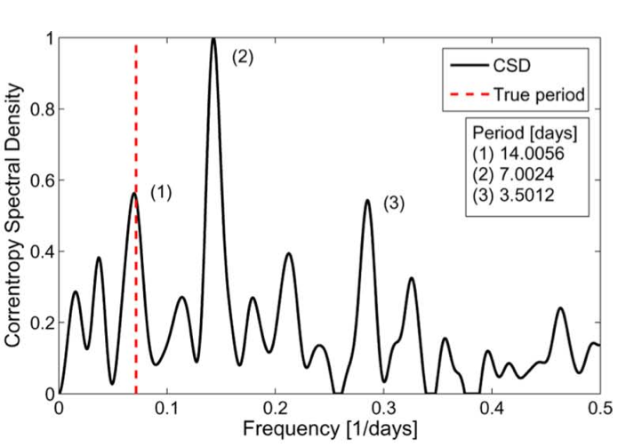

Slide 21
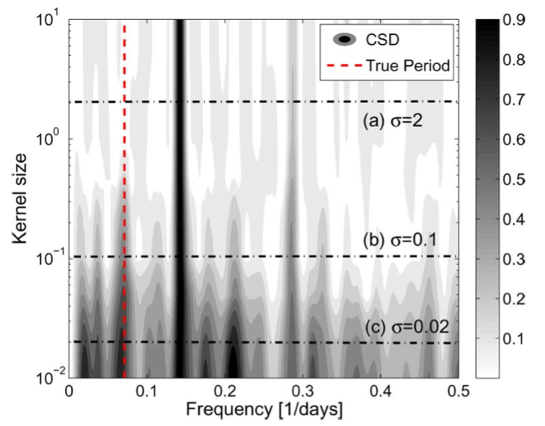
Parameters
Gaussian kernel size: If it is set too large the higher- order moments in correntropy will be ignored. If it is set too small then correntropy will not be able to discriminate between signal and noise.
We repeat for 25 values of the kernel size in the interval. Each kernel size provides trial periods.
Notes:
ADD IMAGES OF LIGHTCURVES

Slide 22
Other parameters
Correntropy slot size Δτ: Set to 0.25 days to capture the shorter periods present in the data set
•Number of peaks analyzed from the CSD: In our experiments we found that setting N_{p}=10 is a good trade-off between obtaining the biggest hit rate and having less computational load.
Notes:
. The slot size defines the time lag resolution of correntropy. If it is set too small, it will be harder to satisfy condition. If it is set too large short periods may not be found.

Slide 23
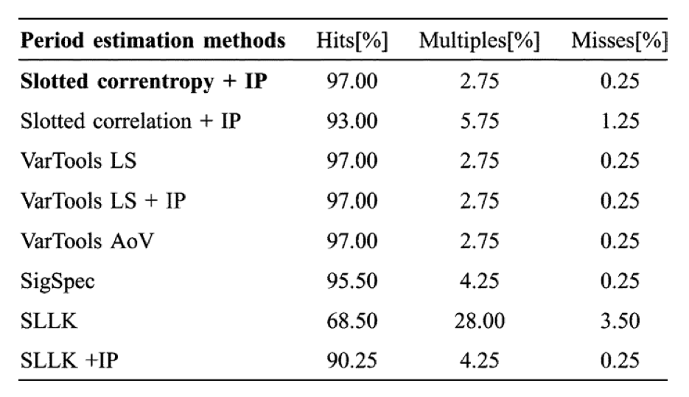
Results RRLyrae and Cepheid
SLLK string length method by (D. Clarke 2002)
SigSpec combines Fourier based methods with statistical metrics of spectral significance (P. Reegen 2007)

Slide 24
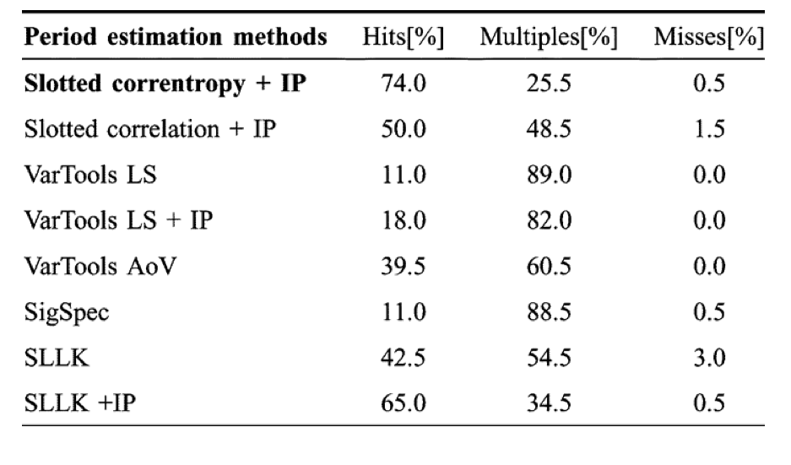
Results EB
P. Hujse et al 2011

Slide 25
2D Kernel
Drawback of the previous method is that we need to tune the parameters of the slotted method.
New idea
Overall Kernel
Notes:
\kappa_{\sigma_m,p}(x_a,x_b) = \frac{1}{\sqrt{2\pi \sigma_m}}\exp{ \left( -\frac{2 \, \sin^2 \left( \frac{\pi}{p}(x_a -x_b)\right) }{\sigma}\right)}
\kappa(h_a, h_b) = \kappa_1(t_a, t_b) \kappa_2(x_a, x_b)
\kappa_{\sigma_t}(x_a, x_b) = \frac{1}{\sqrt{2\pi \sigma_m}}\exp{ \left( - \frac{(t_a-t_b)^2}{2 \sigma_t^2 } \right)}

Slide 26
Can we discriminate periodic from not-periodic ?
Period discrimination metric
Notes:
H(P_c) = -\log \left[ \frac{ (\sum_{i=1}^N \sum_{j=1}^NG_{\sigma_t; P_c}(t_i-t_j) ) G_{\sigma_m; P_c}(x_i-x_j) }{\left( \sum_{i=1}^N \sum_{j=1}^N G_{\sigma_t; P_c}(t_i-t_j) \right)}\right]

Slide 27
Method
Obtain the period that minimizes the previous equation Pt
Obtain H(Pt ), the value of the period discrimination metric at Pt.
Select a significance level α. The significance level defines the confidence degree of the test (1 − α) · 100%. The significance level is typically set between 0.001 and 0.05, hence obtaining confidence degrees between 95% and 99.9%
Generate M = 1/α − 1 surrogates using shuffling.
Obtain H_{Si}(Pt ), the value of the period discrimination metric using period Pt and the surrogate light curve Si . Repeat for the M surrogate light curves.
The null hypothesis is rejected, with a confidence of (1 − α) · 100%,
if H (Pt ) < H_{Si} (Pt ) ∀i ∈ {1, 2, . . . , M }.

Slide 28
Results
Test on optical lightcurves with about 500 epochs in about 8 years with typical periods
between ½ days and 100 days and SNR < 20, taken from EROS, MACHO and OGLE DB

Slide 29
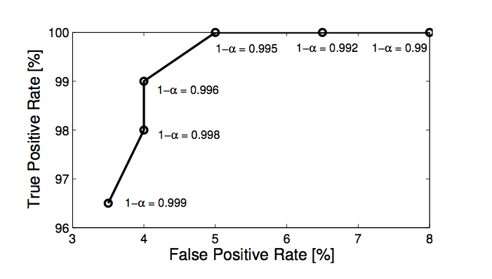
Results

Slide 30
False Positives (FP)
4% is too high considering we want to look into millions of lightcurves
Further examination of FP have alias of 1 day or 29.5 days.
Remove those in a test containing 200 periodic and 2000 non periodic we found 2 FPs

Slide 31
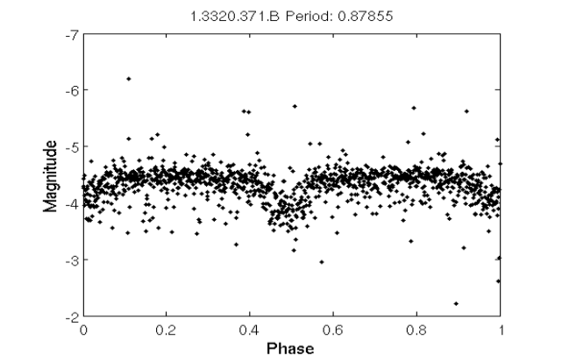
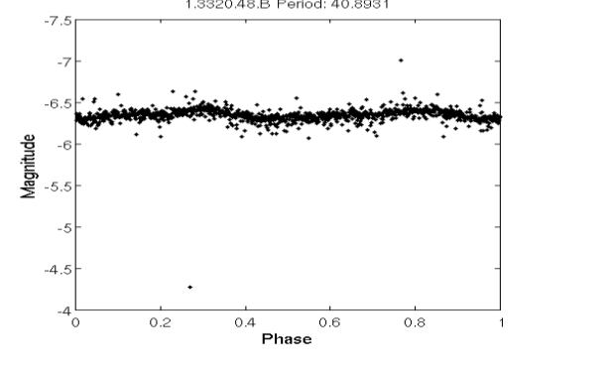

Slide 32
Computational aspects
With the 2D periodic kernel we do not have to worry of slotted parameters but P is an unknown.
One has to try many different periods.

Slide 33
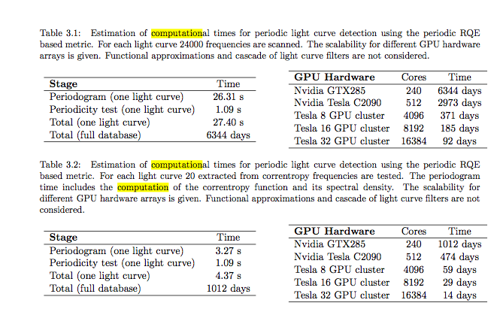

Slide 34
Nonparametric Bayesian Estimation of Periodic Functions using GP work with Yuyang Wang, Roni Khardon
Gaussian Processes has been widely used in the Bayesian literature by substituting a parametric latent function with a stochastic process with a Gaussian prior.
Not the first Bayesian approach
(P. Gregory and T. Loredo, “Bayesian periodic signal detection: Analysis of ROSAT observations of PSR 0540-693,” The Astrophysical Journal, vol. 473, p. 1059, 1996.

Slide 35
Gaussian Processes
Has been widely used in the Bayesian literature by substituting a parametric latent function with a stochastic process with a Gaussian prior.
A collection of random variables, any finite number of which has a joint Gaussian distribution (a generalization of a multivariate Gaussian distribution to infinitely many variables).
Gaussian regression model is given by
where f’s prior is a zero mean Gaussian process with covariance function K and ε is an independent zero mean white noise with variance σ².
Notes:
y = f(x) + \epsilon

Slide 36
Problem definition
In the case of period estimation
x_{i} are scalars x_{i} representing the corresponding time points, x = [x₁,...,x_{n}]^{T}.
The underlying function f(·) is periodic with unknown period φ
Given the data {xi,yi}, our main task is to infer the frequency w (=1/φ)
However we can estimate underlying function f, through the posterior mean <f> (the WOW factor)

Slide 37
the idea
To model the periodic aspect we use a GP with a periodic kernel
where the hyper parameters are θ=β,w,l
Notes:
K_{\theta} = \beta \exp{} \left\{ -\frac{ 2 \sin^2(w\pi(x_i-x_j))}{l^2} \right\}

Slide 38
problem definition
We draw from
Then given f and x we sample for y as
And of course our goal now is to find θ and σ² that best describe the data (x,y)
Notes:
f | \theta \sim \exp \left\{ - \frac{1}{2} \| f \|^2_{K_{\theta}}\right\}
y \sim N( f(x), \sigma^2 )

Slide 39
Model selection
Bayesian approach identify the hyper-parameters that maximize the marginal likelihood.
Notes:
\theta^\star,\sigma^\star = \arg\max\left[ \log [ Pr(y|x;\theta,\sigma) ]\right]
\log Pr(y|x;\theta, \sigma) = \log \int Pr(y|f,x;\theta, \sigma) Pr(f| x; \theta, \sigma)
= \frac{1}{2}y^T(K+\sigma^2)^{-1} y - \frac{1}{2} \log | K + \sigma^2 |^{-1} \\-\frac{n}{2} \log{2 \pi}

Slide 40
model selection
typically, one can optimize the marginal likelihood by calculating the derivatives and then use gradient based search
Fix all other parameters
Many local minima at high frequency (low period)
Maximum is the correct answer.
Steepest decent should not be the choice of maximization

Slide 41
model selection
Two approaches:
Maximum likelihood
Cross validation
Pick parameters (θ,σ) and minimize the empirical loss of a hold out set. Typical leave-one-out (LOO) formulation:
where the subscript -1 mean all but the i^{th} sample.
Notes:
\frac{\partial}{\partial\theta_j}\log \Pr(y|x; \theta, \sigma) =\text{Tr}\left(\left(\alpha\alpha^T - K_\sigma^{-1}\right)\frac{\partial{K_\sigma}}{\partial\theta_j}\right)
where $K_\sigma=K+\sigma^2 I$ and $\alpha = K_\sigma^{-1}\,y$
$\theta,\sigma=\underset{\,\,\,\,\,\,\theta,\sigma}\arg \! \min \sum_{i=1}^{n} (y_i-\hat{f}_{-i}(x_i))^2 $where $\hat{f}_{-1}$ is defined as the posterior mean given the data $\{x_i,y_i\}$ in which the subscript $-i$ means allbut the $i$th sample

Slide 42
optimization
Needs to compute the kernel matrix w.r.t. each frequency and invert the corresponding kernel matrix, and therefore the total time complexity is O(N³)
We do not iterate until convergence
Two level grid search for frequency
Sampling randomly and combining samples
Expanding the K matrix in the neighborhood and using either Sherman-Morisson-Woodbury or Cholesky factors

Slide 43
Data set 1: Harmonic
where a, b∼Uniform(0, 5),ω∼Uniform(1, 4),
φ_{i}∼ N(0,1) and the noise level σ² is set to
be 0.1.
Note this is the same as LS
Data set 2: GP
β,l uniformly in (0,3] and (0,3]
noise level σ² is set to be 0.1.
period is drawn from a uniform (0.5,2.5].
Notes:
Don’t forget to explain PDM
y\sim N(a\sin{(wx+\phi_1)}+b\cos{(wx+\phi_2), \sigma^2})

Slide 45
Notes:
Don’t forget to explain PDM
y\sim N(a\sin{(wx+\phi_1)}+b\cos{(wx+\phi_2), \sigma^2})

Slide 46
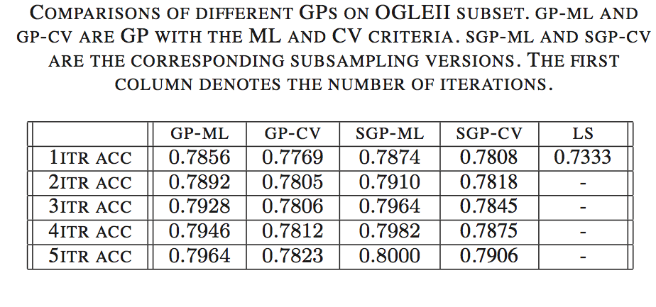
Results on OGLEII data

Slide 47
Conclusions
Period estimation is important for certain phenomena but also a must for classification
Present new ideas that are promising
Correntropy is fast but needs tuning,
GP is slow but has the right framework (I DID NOT)
Computational expense is now the biggest obstacle
Better training sets

